Slide 1
Velocys Pilot Plant Reactors for Catalyst Discharge Development
Orientation and overview

Slide 2
Catalyst Discharge Development
Reactors
Velocys Pilot Plant Reactor 4D (VPP4D)
Velocys Pilot Plant Reactor 2 (VPP2)
-reactor currently operating and soon to be ready for discharge development work
-’core’ of reactor encased in pressure containment shell (PCS)
-reactor with hard to discharge catalyst
-possibly representative of ‘off condition’ reactor
-does not have PCS like VPP4D

Slide 3
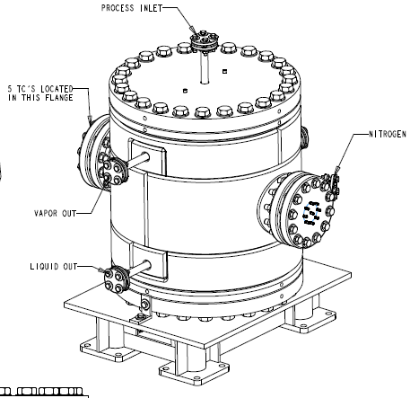
Catalyst Discharge Development
Velocys Pilot Plant Reactor 4D (VPP4D) Overview
Velocys Pilot Plant Reactor 4D (VPP4D):
-2 process layers (total of 6 waveforms)
-Core contained within pressure containment shell (PCS) pressurized with nitrogen
-approximate weight w/o headers is 3200lb
-process headers will be removed post operation prior to catalyst discharge
-catalyst retention materials will be removed prior to catalyst discharge
*Stand shown in drawings will be replaced with stand shown on next slide.
Ref. Drawing #: 1005875

Slide 4
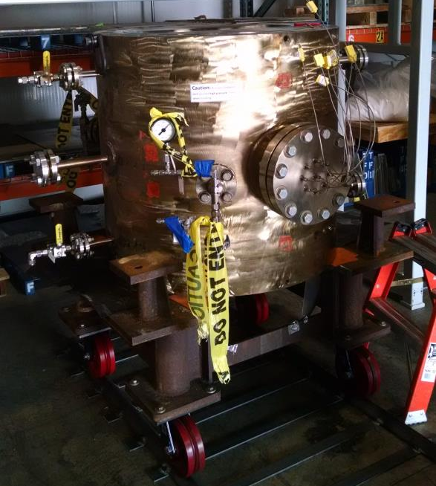
Catalyst Discharge Development
VPP4D stand
Reactor stand for catalyst discharge development:
-Allows for ~24 inches of clearance under the reactor to access entire process outlet face
-can be put on angle iron ‘track’ or positioned freely on floor.

Slide 5
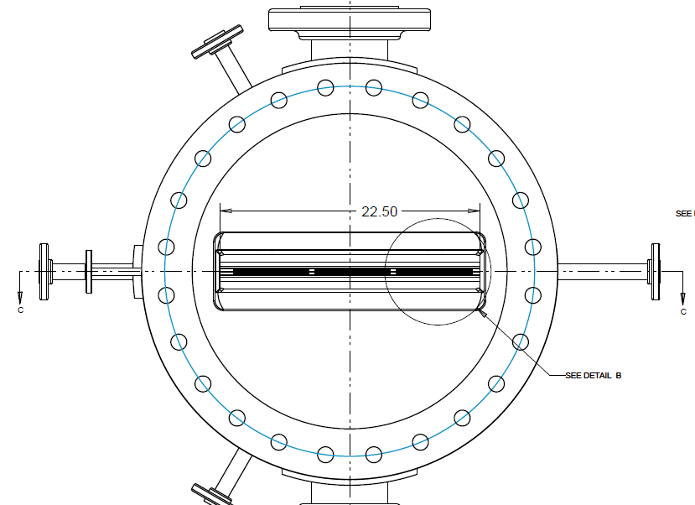
Catalyst Discharge Development
VPP4D- Top down view of process inlet face
Thermocouple Access Port
PCS pressure fill port
Coolant Inlet →
Coolant Outlet
→
*process inlet and outlet headers are mirror images of one another (same dimensions)
2 layers
(3 waveforms each)
PCS pressure drain port
Thermocouple Access Port
Ref. Drawing #: 1005873

Slide 6
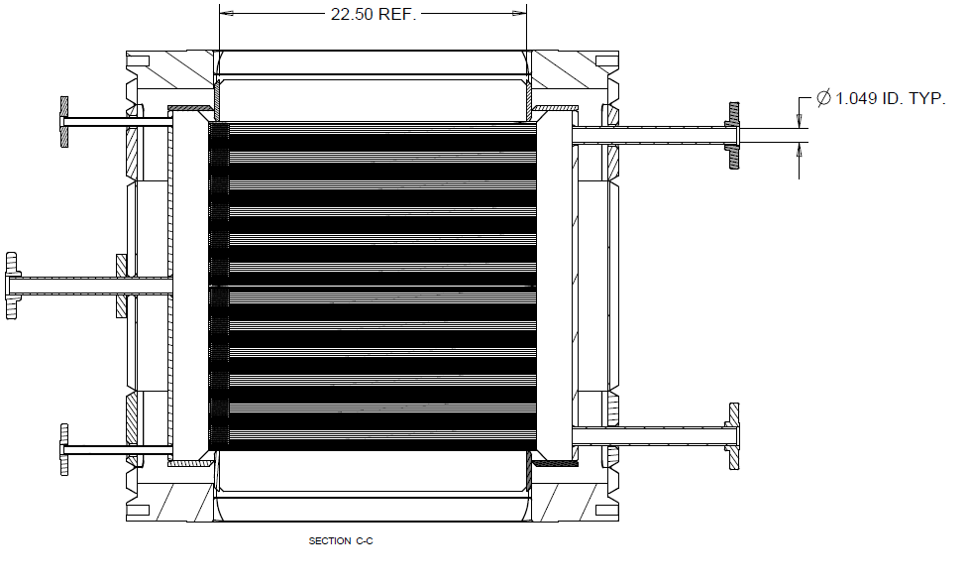
Catalyst Discharge Development
VPP4D Cross section of coolant system
Coolant Purge
Coolant Outlet
(Vapor) →
Process Inlet
Coolant Inlet →
Coolant Inlet header
Coolant Outlet header
Coolant Outlet
(Condensate) →
Coolant Drain
Process Outlet
Ref. Drawing #: 1005873

Slide 7
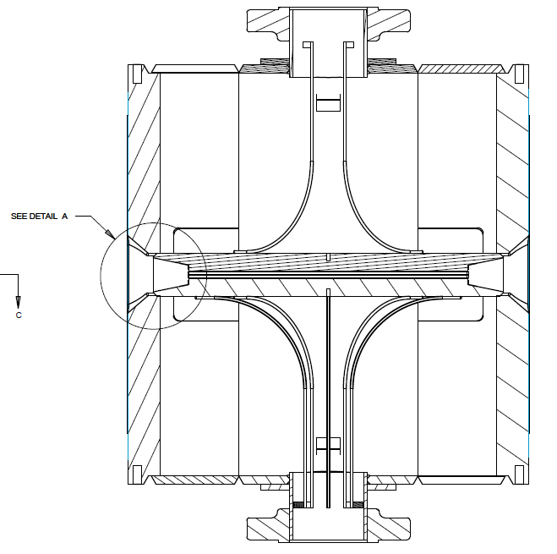
Catalyst Discharge Development
VPP4D- Cross section of Process Layers
Thermocouple sheaths and access port
Process Layers (2 layers, 6 waveforms)
Process Inlet →
→ Process Outlet
Thermocouple sheaths and access port
Ref. Drawing #: 1005873

Slide 8
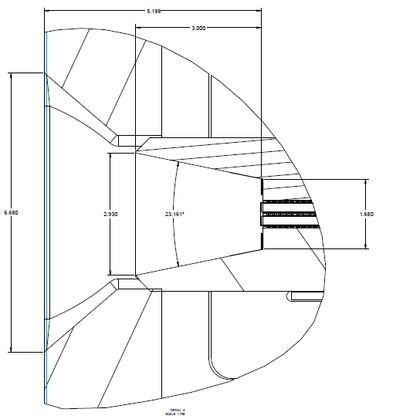
Catalyst Discharge Development
VPP4D – Process Header (detail A)
Top down view of process header
Process headers taper from ~6.7 inches to ~1.7inches at the process face.
*Dimensions clear in PDF of drawings
Ref. Drawing #: 1005873

Slide 9
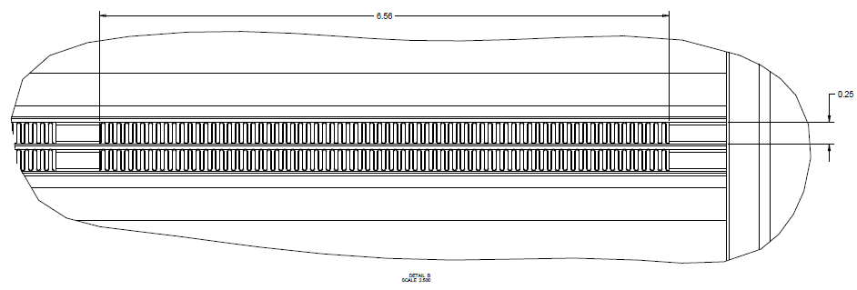
Catalyst Discharge Development
Top down view of process channels (detail B)
Copper waveforms are ~6.5 inches by ~0.25 inches and extend ~24 inches through reactor.
Ref. Drawing #: 1005873

Slide 10
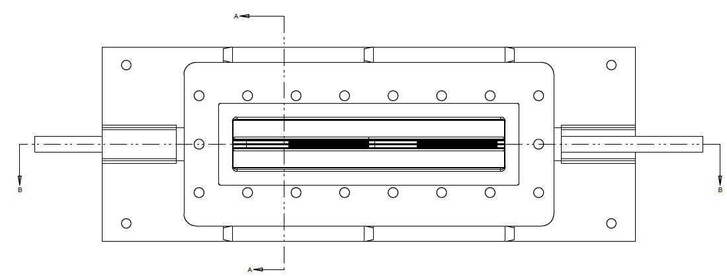
Catalyst Discharge Development
VPP2 Top down view of process inlet
Additional support added to reactor post fabrication (not shown in drawings)
Coolant Inlet →
Coolant Outlet
→
Process Inlet
Additional support added to reactor post fabrication (not shown in drawings)
Ref. Drawing #: 1002984

Slide 11
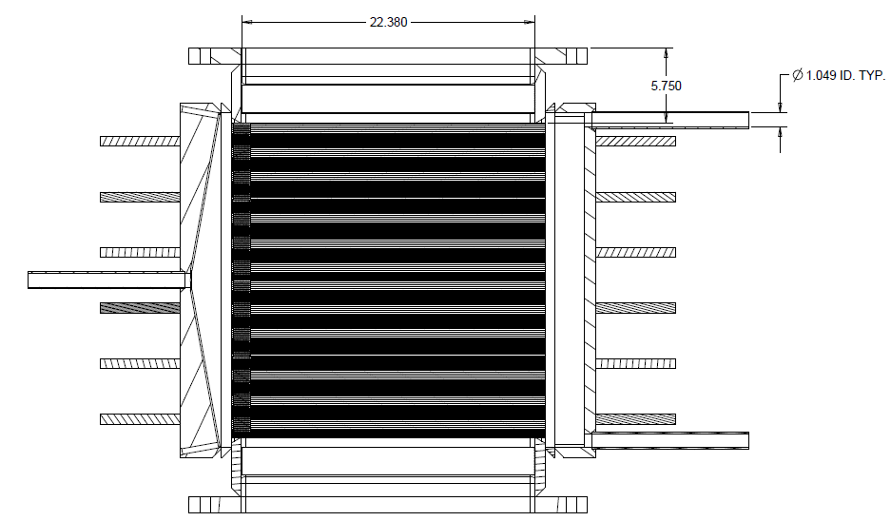
Catalyst Discharge Development
VPP2- Cross Section of Coolant
Process Inlet
Coolant Outlet
(Vapor) →
Coolant Inlet →
Coolant Inlet header
Coolant Outlet header
Coolant Outlet
(Condensate) →
Process Outlet
Ref. Drawing #: 1002984

Slide 12
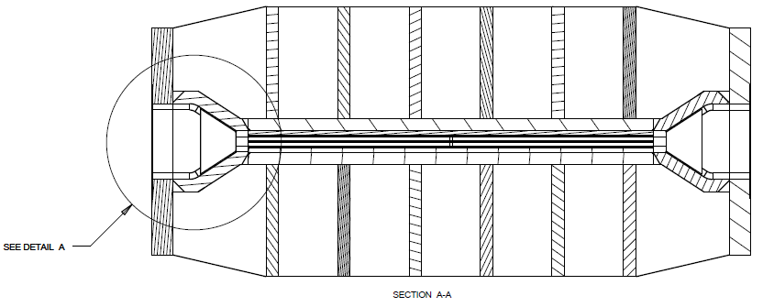
Catalyst Discharge Development
VPP2- Cross Section of Process Layers
Additional supports (not shown in drawings)
Process Layers (2 layers, 6 waveforms)
→ Process Outlet
Process Inlet →
Additional supports (not shown in drawings)
Ref. Drawing #: 1002984

Slide 13
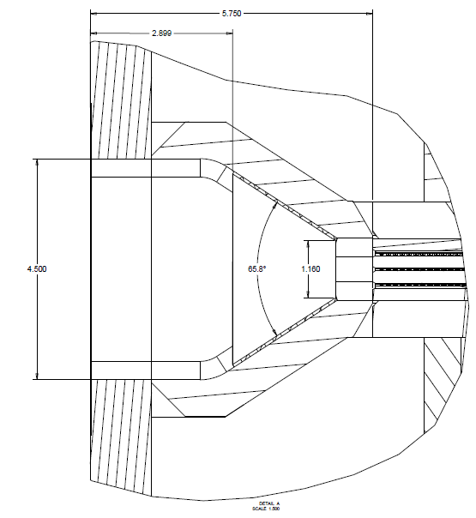
Catalyst Discharge Development
VPP2 cross section of process header
Ref. Drawing #: 1002984

